Slide 1
Mass Spectrometry Data Formats
By Sam LaRue and Will Kumler

Slide 2
The Problem
Raw MS Data Formats Limitations:
Raw mass-spectrometry data is often stored in vendor-specific formats or .mzML files
These encode retention time, m/z ratio, and intensity
Existing formats lack intuitive, rapid, and easy to use search capabilities
Users must understand idiosyncratic file formats, which hinders accessibility and interoperability
Challenges with Current Methods:
Difficulty in performing efficient queries and data extractions
Inefficient handling of multi-file data aggregation
Limited support for storing processed data alongside raw data
Reliance on formats not actively supported by larger development communities

Slide 3
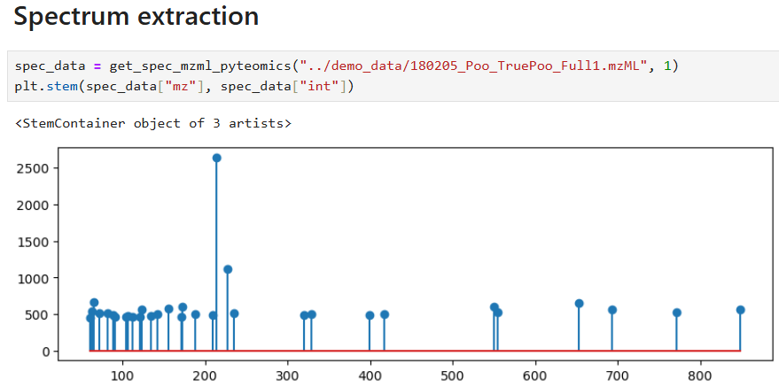
Problematic: only useful if the arbitrary ID number is somehow known in advance

Slide 4
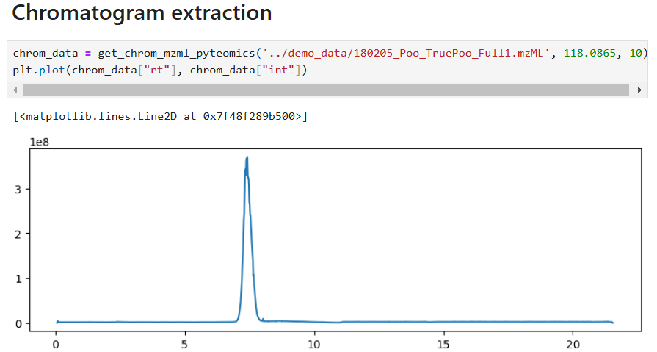

Slide 5
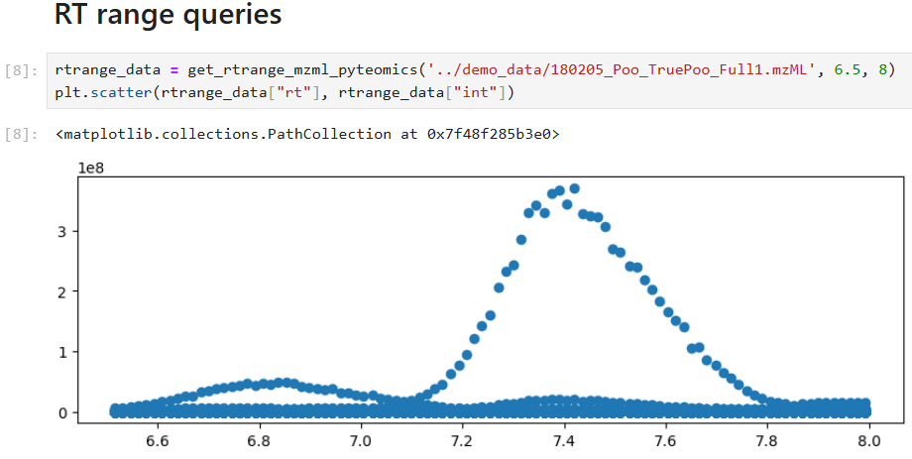

Slide 6
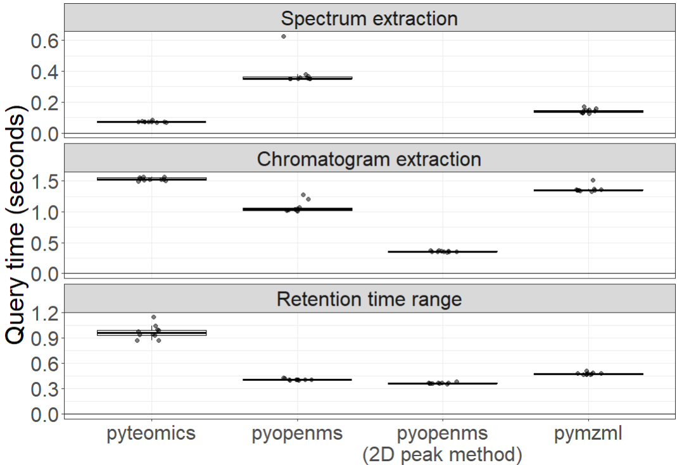

Slide 7
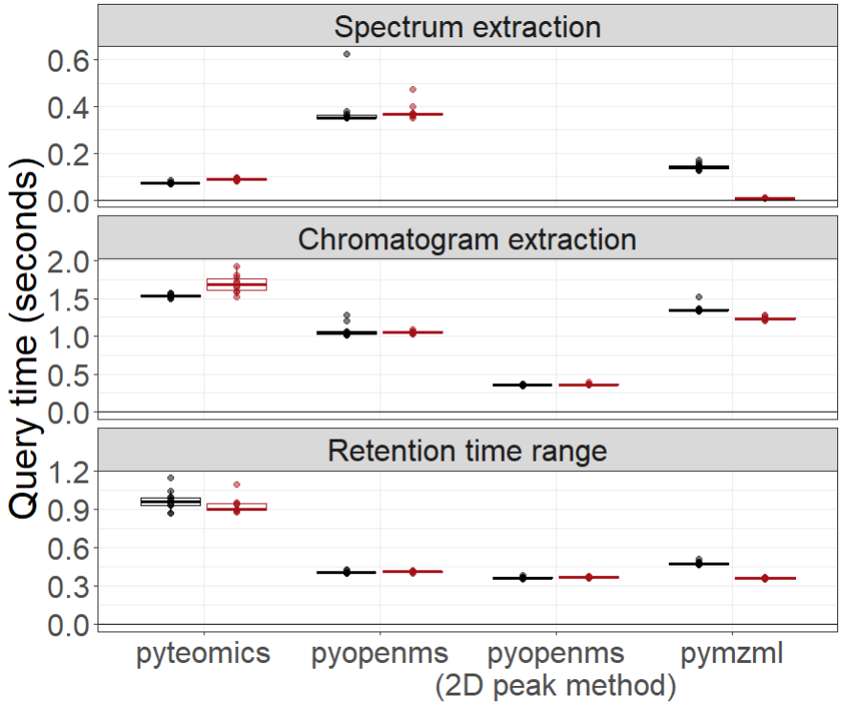
Regular
Indexed

Slide 8
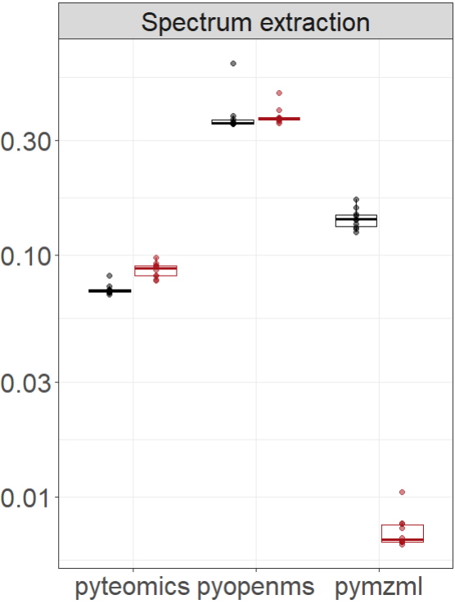
Regular
Indexed
Regular mzML
Indexed mzML

Slide 9
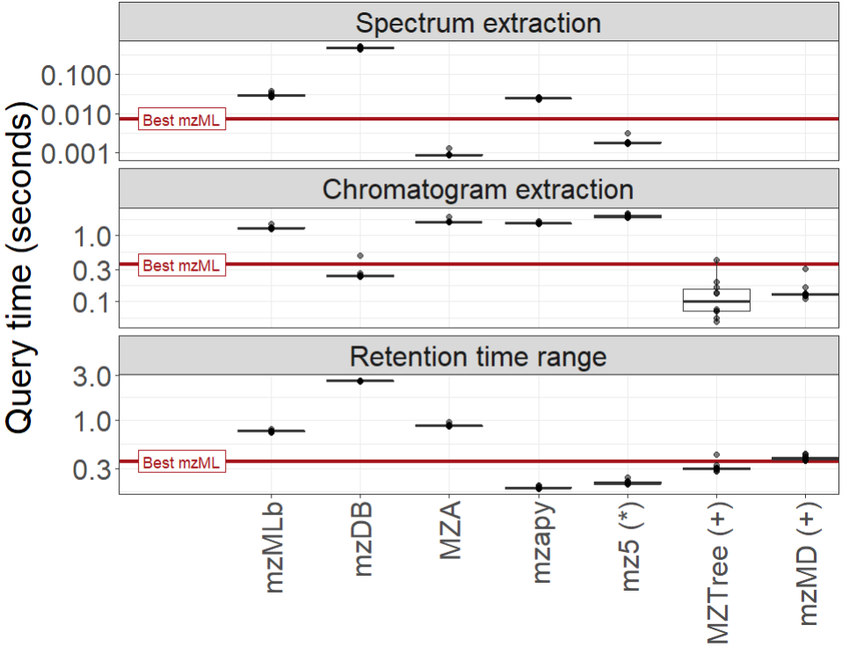
*mz5 returns slightly different values
⁺mzTree/mzMD require manual loading

Slide 10
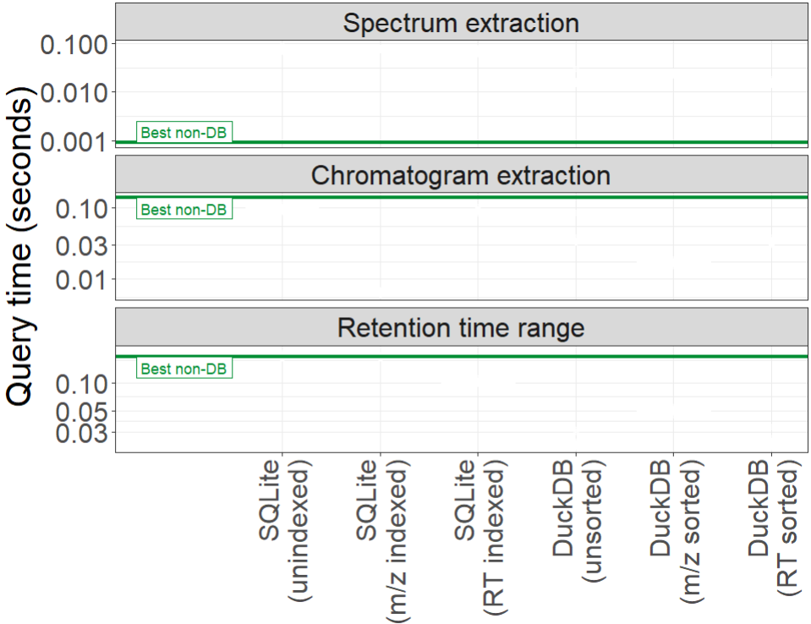


Do databases perform better than the existing file types?

Slide 11
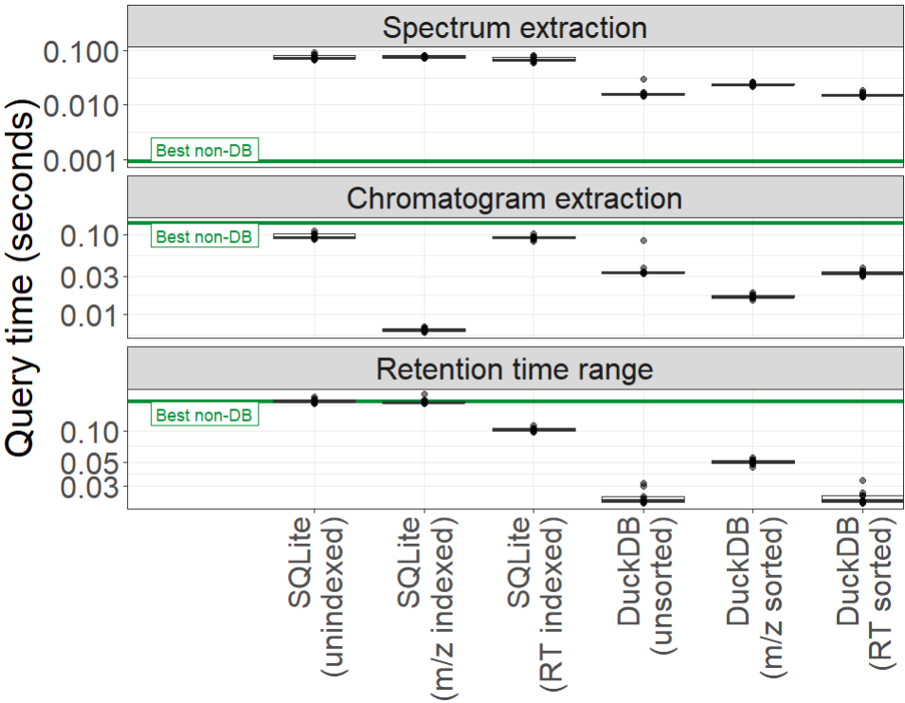

Slide 12
This metric was dumb anyway (so we didn’t optimize for it)

Slide 13
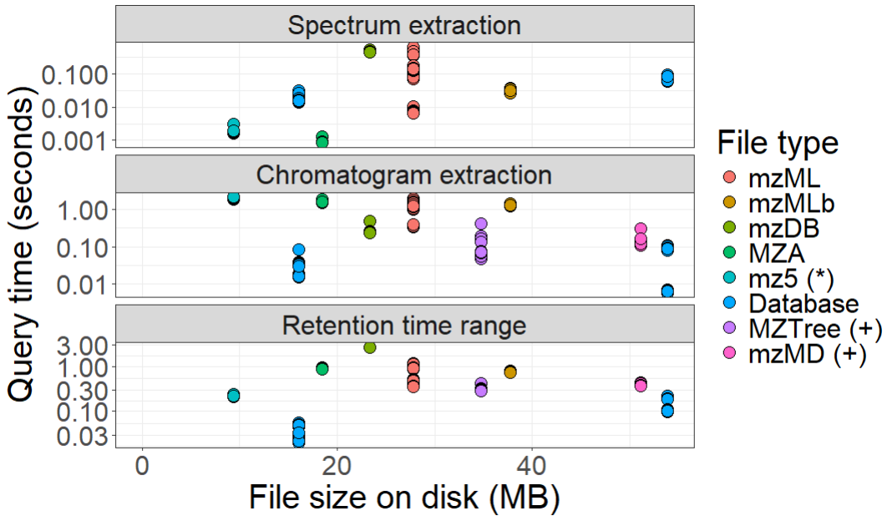
Fundamental tradeoff between speed and size with DuckDB as an exception!
DuckDB
SQLite

Slide 14
Future Work
Multi-file comparisons
Existing MS data formats preserve the idea of "one sample = one file"
Develop methods for managing MS datasets that contain multiple files
Create systems to integrate new data files into existing aggregated datasets without reprocessing
Current methods have a linear increase every time a file is added
Parallel processing techniques???
Bottlenecks or other issues???

